Slide 1
MTO reactor section
Timothy Ng Tik Ti
A0110716U
Team 10
CN4123 Design Project

Slide 2
Scope of Presentation
Overview of Complete Process
Methodology and Design of Reactor Unit
Process Development for the section
Notes:
-Firstly, I will provide you with the overview of the complete process of our methanol to olefins plant, in particular the specifications
-methodology used to find our process parameters as well as our design of our reactor unit
-after which, we will then talk about the development of our reactor section process. Due to time constraint however, only the highlights of our reactor section will be discussed in this section

Slide 3
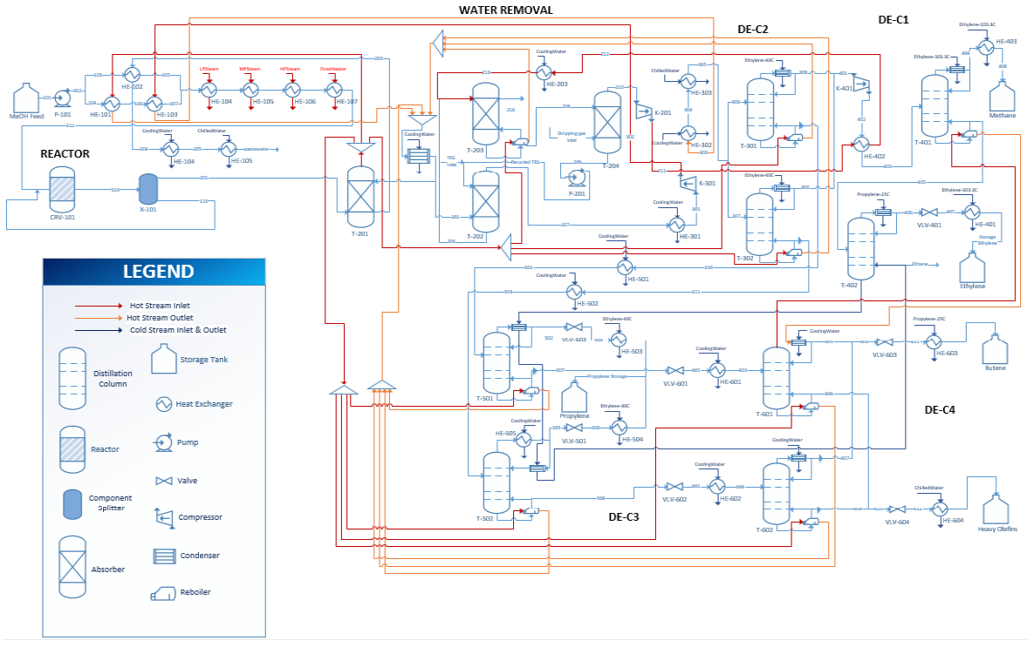
Overall Process and purpose of reactor section
Notes:
The aim of the MTO plant is to attain
-800 kt/a of light olefins. At least 99.9 wt% purity of ethylene and propylene of 94 wt% purity. The butylene out of the plant should be 99 wt% in purity, and the recovery should be high.
-So the reactor section is basically responsible for producing enough products so that even after downstream processing there will still be enough olefins to meet our specifications
-The configurations in the reactor section currently is slightly different to the one provided in the section report. For todays purposes however, I will be talking about the configurations made IN the section report, and provide some justifications for them

Slide 4
Purpose of Reactor Section
To generate at least 800 kt/a light olefins using methanol using a solid catalyst
Ensure sufficient light olefins and butylene available for downstream processes to achieve specifications
Notes:
-Methanol feed has 99.6 wt% methanol, and 0.4 wt% water as impurity

Slide 5
Methodology and Design of Fluidized Bed Reactor Unit

Slide 6
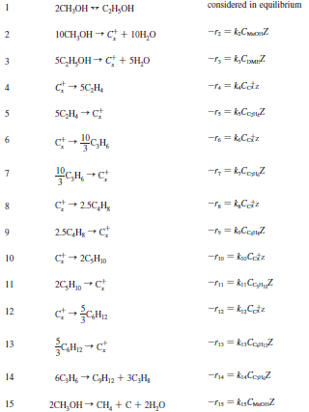

Kinetics
Utilized ZSM-5 kinetics obtained from Kaarsholm et al
Able to simulate overall trends of light olefins well
Accurate for 450 ºC to 550 ºC
Poor in trends for paraffins and heavier olefins, and oxygenate conversion
Requires improvement in representing species concentration
Notes:
-modifications made as well, removal of equation 14 and changing of the k value of equation 15

Slide 7
Modification to kinetics
Additional equation describing equilibrium
Rate constant of equation 15 was changed to 0.5, and equation 14 was removed entirely
Ethane and propane introduced manually

Slide 8
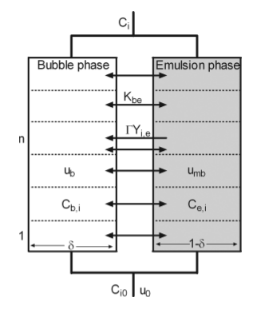
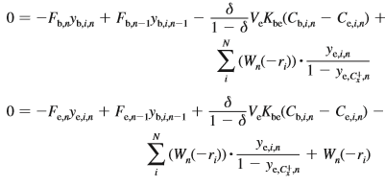
Bubbling Fluidized Bed Model
Obtained from Kaarsholm et al as well
Assumptions were made with regards to design equation
Additional assumptions were imposed in our code
Notes:
Assumptions
1. Gas flows only in the axial direction, and dispersion in the radial direction is not considered
2. No catalyst present in the bubble phase
3. Activity of the catalyst is considered constant
Additional assumptions
1. Reactor is isothermal.
2. Reactor is isobaric, assuming pressure drop across the bed is significantly lower than the reactor pressure.
3. The gas is assumed to be of ideal behaviour. This is to allow the usage of ideal gas correlations in our simulation.
4. No internal mass transfer within the catalyst, mass transfer only occurs between bubble and emulsion phase.
5. No deactivation of catalyst.
6. Catalyst particles are suspended and there are no overall upward or downward flow with the exception of entrained particles arising from bursting bubbles.

Slide 9
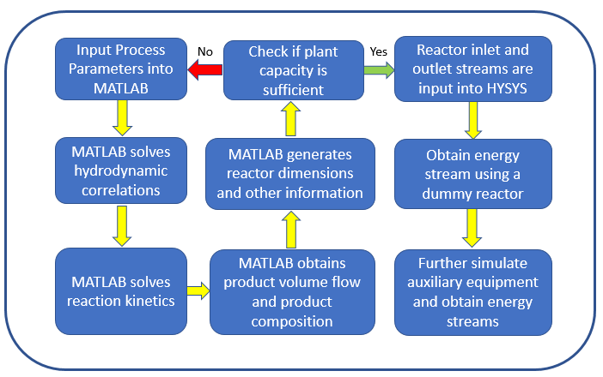
Code methodology
Notes:
-In order to produce our light olefins, we have decided to utilize a fluidized bed reactor
-We have decided to use kinetics from Kaarsholm et al, and utilize ZSM-5 for the catalyst of choice for our fluidized bed reactor
-We wrote a code using the design equations to simulate the fluidized bed reactor, and this is the methodology

Slide 10
Selection of Process Parameters
Should obtain more than 880 kt/a capacity
Maximize profit
Optimized temperature, pressure, WHSV with respect to section profitability
Catalyst parameters, temperature, pressure, weighted hourly space velocity (WHSV), feed rate, internal diameter and height of reactor
Notes:
-In the selection of our process paramters for our reactor, they should allow us to obtain more than 880. The extra 80 is to account for possible losses downstream
-The process parameters should maximize profit margin of the section, and optimization is done so to ensure that. Optimization will be performed using 3 parameters, namely…..
-Other parameters that we will be looking at include…, but these are interrelated to the optimized parameters and as such only 3 parameters will be looked at for optimization

Slide 11
Optimized results of temperature, pressure and WHSV
When temperature was increased from 450ºC to 550ºC, the capital and operating expenditures increased. However, profit margin increased due to increased plant capacity. 550ºC was chosen.
When pressure was increased from 1 atm to 30 atm, capital and operating expediture were found to decrease. Profit margin was found to increase despite lower plant capacity due to an increase in butene fraction. As such, 30 atm was chosen
Plant capacity was found to first increase sharply with increasing contact time initially, then decreases. The optimum plant capacity was found to occur at a WHSV of 134h⁻¹

Slide 12
Obtaining Reactor Diameter and Height
Reactor Diameter
Minimum fluidization velocity was first determined
Design superficial velocity was set at 8.5 times minimum fluidization velocity
Design superficial velocity was checked against terminal velocity of particles
Feed volumetric flow rate was decided, and used to determine the area, and thus the diameter needed
Reactor Height
Bed volume at minimum fluidization was calculated using bed density and mass of catalyst required
Using reactor diameter and bed volume, bed height was calculated
Bed height was checked to ensure no slugging would occur
Transport Disengagement Height (TDH) was calculated
Additional allowance to height was added to make space for cyclones and feed distributor
Notes:
8.5 times is to ensure adequate turndown and prevent excessive entrainment of catalyst

Slide 13
Reactor Parameters
Parameter | Value
Reactor Internal Diameter (m) | 9.915
Reactor Height (m) | 5.849
Bed Height at minimum fluidization (cm) | 5.13
Methanol Feed Rate (kt/a) | 3161
WHSV (h⁻¹) | 134
Mass of Catalyst used (kg) | 2949
Operating Pressure (atm) | 30
Operating Temperature (ºC) | 550
Plant Capacity (kt/a) | 882.6
Notes:
These are the parameters obtained. Using these parameters, the profit is maximized while maintaining a plant capacity of at least 880 kt/a.
TDH = 1.074m
Methanol feed rate ensure that 880 kt/a was produced

Slide 14
Development of Section Configurations and Equipment Design Considerations
Notes:
-Due to time constraint I will be only talking about the highlights

Slide 15
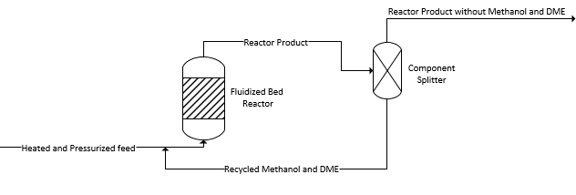
Recycle configuration
Component splitter is representative of all the purification and separation processes required to separate a pure stream of methanol and dimethyl ether from the reactor outlet stream
Using the same operating parameters and the same reactor dimensions, a methanol conversion of 98.2% and a plant capacity of 882.6 kt/a were attained. This is in contrast with the 85.2% methanol conversion and a plant capacity of 739.5 kt/a obtained without the recycle stream.
Notes:
-One of our highlights is the utilization of recycle configuration. This is because originally our methanol conversion was found to be rather low, at 85.2% methanol conversion. After after the recycle was introduced, it increased to 98.2% plant capacity.
-As such, this decreases the amount of methanol feed required to hit our specifications of 880kt/a , and reduces the amount of methanol wasted. Thus, saving raw material costs.
-Realistically, the series of separation processes required for this to occur would incur much cost and design considerations. However, for the sake of simplification, the costing and design of these separation processes were assumed to be negligible as briefed during the leaders meeting.

Slide 16
Regeneration of catalyst
Hydrogen treating, proposed by Forbus et al.
Able to regenerate zeolite catalyst in situ, while the reactions are happening
Reduces capital cost
Longer lifespan of catalyst compared to traditional method of burning of coke in air in a separate regenerator
Need to elevate pressures to 35 atm at times to regenerate
Flow rate of hydrogen was found to be 98.47 kt/a
Notes:
-Another highlight is the method in which we decide to regenerate our catalyst.
-In order to regenerate the catalyst, we have decided to use hydrogen treating, which proposed by forbus In a patent published in 1988.
-Through this method, it is possible to regenerate zeolite catalysts, such as ZSM-5, in situ, while the reactions are happening. As such, this reduces capital cost in designing and constructing a regeneration system.
-In addition, this method can provide a longer lifespan of catalyst compared to traditional method of burning of coke in air in a separate regenerator, and as such reduce the amount of catalyst that needs to be replaced.
-A point to note is that in order to continuously regenerate the catalyst, sometimes pressure would need to be increased to 35 atm.
-It was recommended by Forbus et al, that the molar ratio of hydrogen to organic reactants be 0.5:1 to 40:1. We have decided to use a conservative estimate of 0.5:1 molar ratio for now to prevent too much deviation from our optimized parameters and design due to the increased inlet volumetric flow rate.
-However in our final report, we have reverted back to the usage of a conventional regenerator, as the cost of hydrogen per annum was found to severely outweigh the savings of a regenerator and replacing catalysts. In addition, the introduction of hydrogen gas can lead to a potential hazard, and with the mixing with methanol and water might incur additional hazard and risk of explosion.

Slide 17
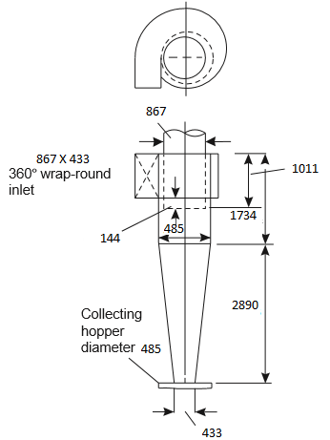

Reactor Design consideration
Reactor shell
Stainless steel grade 410
Thickness of 23.2 cm was calculated using Section VIII of the ASME Boiler and Pressure Vessel Code
Reactor auxiliary
8 cyclones of 6.835 m³ volume, placed above TDH
Cooling coil of 127300 kW duty, with surface area of 393.3 m²
Porous plate distributor with 77220 orifices of size 5.525 mm needed
Notes:
Since methanol and water can be corrosive, stainless steel will be strong enough to withstand the high temperature of 550oC
Thickness was calculated using Section VIII of the ASME Boiler and Pressure Vessel Code, the minimum thickness required for a cylindrical vessel wall to resist the internal pressure. The design pressure P_{i} was taken to be 10% above our normal operating pressure of 30-35 atm, and as such was chosen to be 38 atm. Factoring in 4mm for corrosion allowance, 23.2cm

Slide 18
Storage of feed
Assumed shipment would arrive every 3 hours
Kept at 25 ºC and 1 atm
Volume after accounting for expansion was decided to be 1550 m³
Stainless steel grade 410 closed tank with floating roof

Slide 19
Heating and pressurizing of feed
Preheating of feed
3 fired heaters would be used
One to heat feed from 25ºC to 172ºC, the boiling point of the feed mixture, the second would be to boil the feed, and the last one to heat the vapor from 172.2ºC to 550ºC
Fuel used was decided to be natural gas
The respective heat duties are found to be as follows: 64300 kW, 72300 kW and 104300 kW
Pressurizing of feed
A pump would be used before the series of fired heaters
An oversized factor of 1.2 was used for a more conservative estimate of pump head, and to account for piping loss
The pump head was found to be 456.8m
Pump duty was found to be 656.4 kW

Slide 20
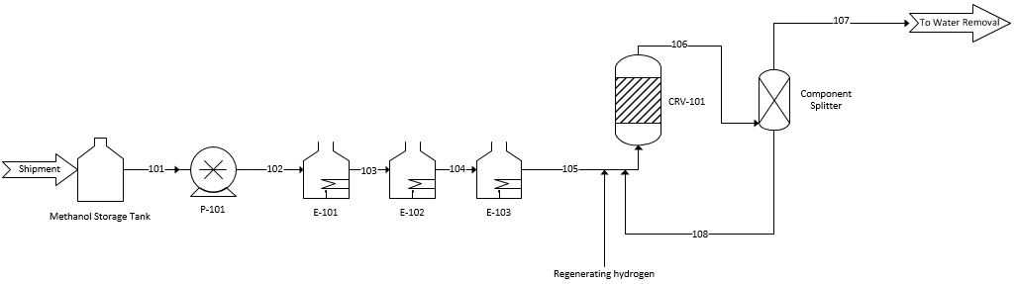
Reactor section configuration

Slide 21
THANK YOU

Slide 22
APPENDIX: Methodology for optimizing temperature and pressure
The reactor was simulated using MATLAB for pressures between 1 atm to 30 atm, while fixing the feed flow rate at 3.73 kmol/s, temperature at 550ºC, and WHSV at 15.67 h⁻¹ to obtain the flow rate and composition of product stream at each temperature point.
The feed pump, heater and the reactor were simulated with Aspen HYSYS by keying in the values obtained from MATLAB.
Feed heating duty and feed pump duty for each pressure point were then obtained from Aspen HYSYS. The feed heating duty was found to decrease with pressure while feed pump duty was found to increase.
The heating duty was assumed to be provided by a 100% thermal efficiency fired heater utilizing No. 2 Heating Oil, which has a heating duty of 9320 kcal/liter and a price of SG$ 0.986/liter.
The cost of feed heating duty was calculated for each pressure point.
The cost of feed pump duty was calculated for each pressure point using the electricity price of SG$ 6.222E-05/kJ.
The cost of feed heating duty and feed pump duty were assumed to be the only contributing component to utility cost, as cost of cooling the reactor was assumed to be provided by seawater and considered negligible.
Raw material cost, comprising of only methanol at the moment, was calculated using the price of SG$ 352.5/tonne.
The Operating Expenditure (OPEX) of the section was then assumed to consist of just the raw material cost and utility cost.
From the MATLAB simulation performed at each pressure point, the reactor dimensions were obtained. Reactor diameter was designed to decrease with increasing pressure to accommodate the expansion in inlet gas volume to maintain the same design superficial velocity U₀, which is given by 8.5 times the U_{mf} as mentioned previously. The bed height decreases naturally as the reactor tube area increases due to the mass and packing density of the catalyst being the same.
Transport disengagement height (TDH) was calculated. Since the superficial velocity at the end of the bed was found to be approximately the same at 0.100 m/s throughout all the temperatures, the transport disengaging height is assumed to be the same, which was found to be 1.019 m.
The height of the reactor was calculated, which we assumed to be simply the sum of the bed height and the transport disengagement height.
The volume of the reactor was then calculated. At 1 atm, reactor volume is found to be huge at 2639 m³ compared to 123.7 m³ at 30 atm due to the huge reactor diameter.
The module costing estimation proposed by Turton et al, was utilized to calculated the bare module cost of the reactor shell. Stainless steel grade 410 was assumed to be utilized for its high maximum temperature and corrosion resistance.
Module costing of furnace and pump was performed by assuming a non-reactive fired heater and a positive displacement pump.
The CAPEX was estimated, by assuming that the only contribution is from the bare module cost of the reactor shell, pump and furnace. CEPCI of 543 for year 2016 was considered. Cost for internals such as cooling coil, cyclone and distributor plate were not considered as a change in design temperature does not change their costing that much, and cost of catalyst was not considered in this section as well due to the WHSV being kept constant.

